Slide 1
Face Emotion Recognition
Team Members
Monica Patil
Rushikesh Vichare
Vinay Sanil

Slide 2
Contents
Problems Statements
Related Research (2)
Proposed Solutions
Data Summary and Important Dependencies
Project Architecture
Training and Test Curves
Model Evaluation
Final Results
Conclusion and Future Work
Challenges and Scope Of Improvement
Final Demo

Slide 3
Problem Statement
Face Emotion detection has been around for ages, taking a step forward, human emotion displayed by face and felt by brain captured in other video electric signal or image form can be approximated. Human emotion detection is the need of the hour so that modern artificial intelligence systems can emulate and gauge reactions from face. This can be helpful to make informed decision be it regarding identification of intent, promotion of offers or security related threats.
It can also be used in different fields, for e.g. Retailers may use these metrics to evaluate customer interest. Healthcare providers can provide better service by using additional information about patients' emotional state during treatment. Entertainment producers can monitor audience engagement in events to consistently create desired content.
Humans are well-trained in reading the emotions of others, in fact, at just 14 months old, babies can already tell the difference between happy and sad. But can computers do a better job than us in accessing emotional states?
So our objective in this project is to train a deep learning model which can detect the emotion of face.

Slide 4
Related Research Paper I
IMAGE PROCESSING FACIAL EXPRESSION RECOGNITION was made by group of students of IT Institute.
Dataset used was FER-2013
CNN Model and Cascade Workflow was used to built the model and the accuracy of the model was around 65%
Challenges was incorrect prediction.
Artificial Neural Network and Deep Convolutional Neural Networks(DCNN) and added multiple dense layer and finally the accuracy achieved was 80.2%
Model predicted correctly

Slide 5
Related Research Paper II
A Facial Expression Recognition System using Convolutional Neural Network was made by a students of Computer Engineering.
Kaggle facial expression dataset was used.
Convolution Neural Network (CNN) based on LeNet Architecture was used
And Haar cascade classifier from OpenCV for frames .
A LeNet architecture based six layer convolution neural network is implemented to classify human facial expressions i.e. happy, sad, surprise, fear, anger, disgust, and neutral.
The system has been evaluated using Accuracy, Precision, Recall and F1-score.
The classifier achieved accuracy of 56.77 % , precision of 0.57, recall 0.57 and F1-score 0.57.

Slide 6
Proposed Solutions
To build this system, we implemented a “YOLOv5”
For labeling the Image, Label Image is used.
And for live demo we have used OpenCV

Slide 7
Data Summary
Our dataset is a collection of captured Images of different emotions. It contains a total of around 300 face annotations, where images are also of various resolution. The dataset incorporates a range of challenges, including difficult pose angles, out-of-focus faces and low resolution. Only color images are used.
Important Dependencies
Pytorch (Torch Vision and Torch)
Yolov5
OpenCV
Git
UUID (For Unique Id)
LabelImg (Custom Annotation Tool)

Slide 8
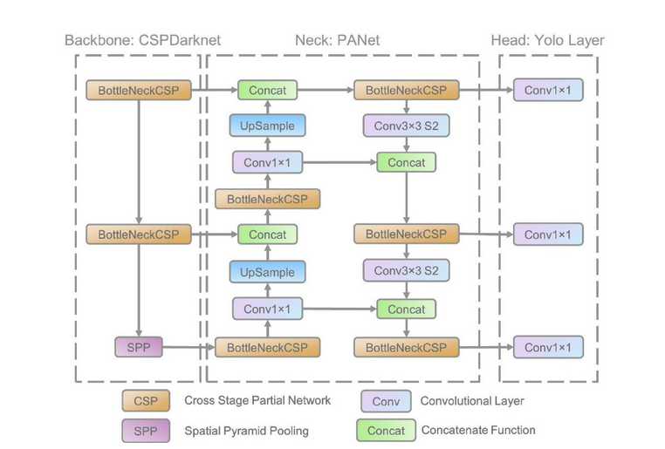
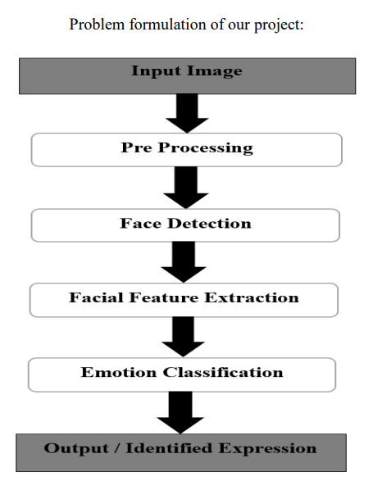
Project Architecture
YOLOv5

Slide 9
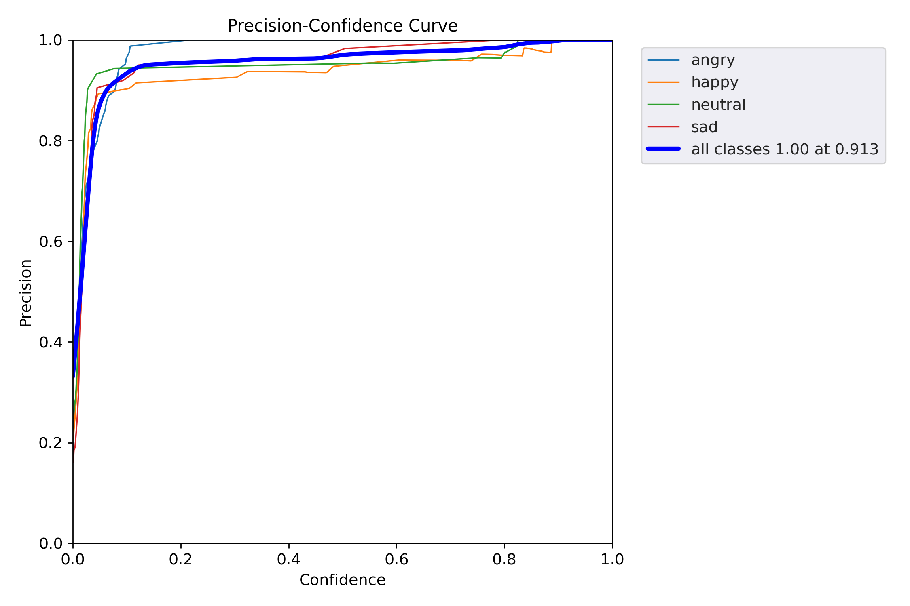
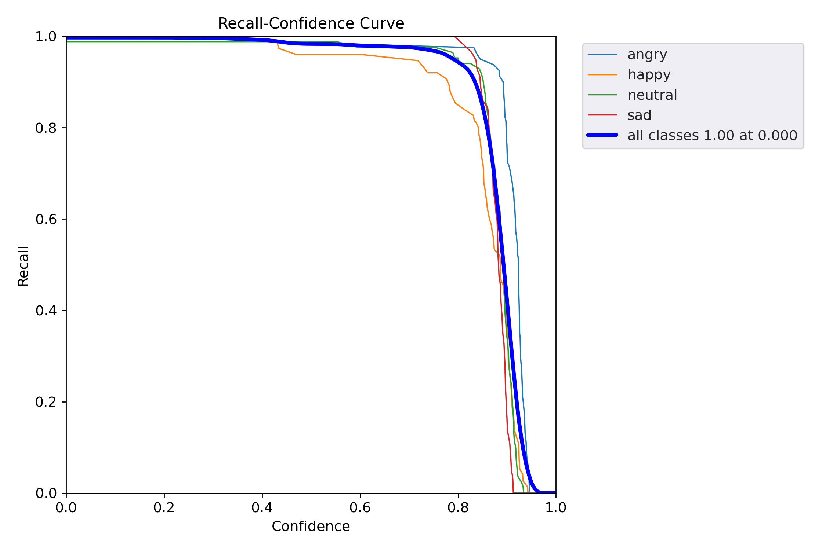
Training and Test Curves

Slide 10
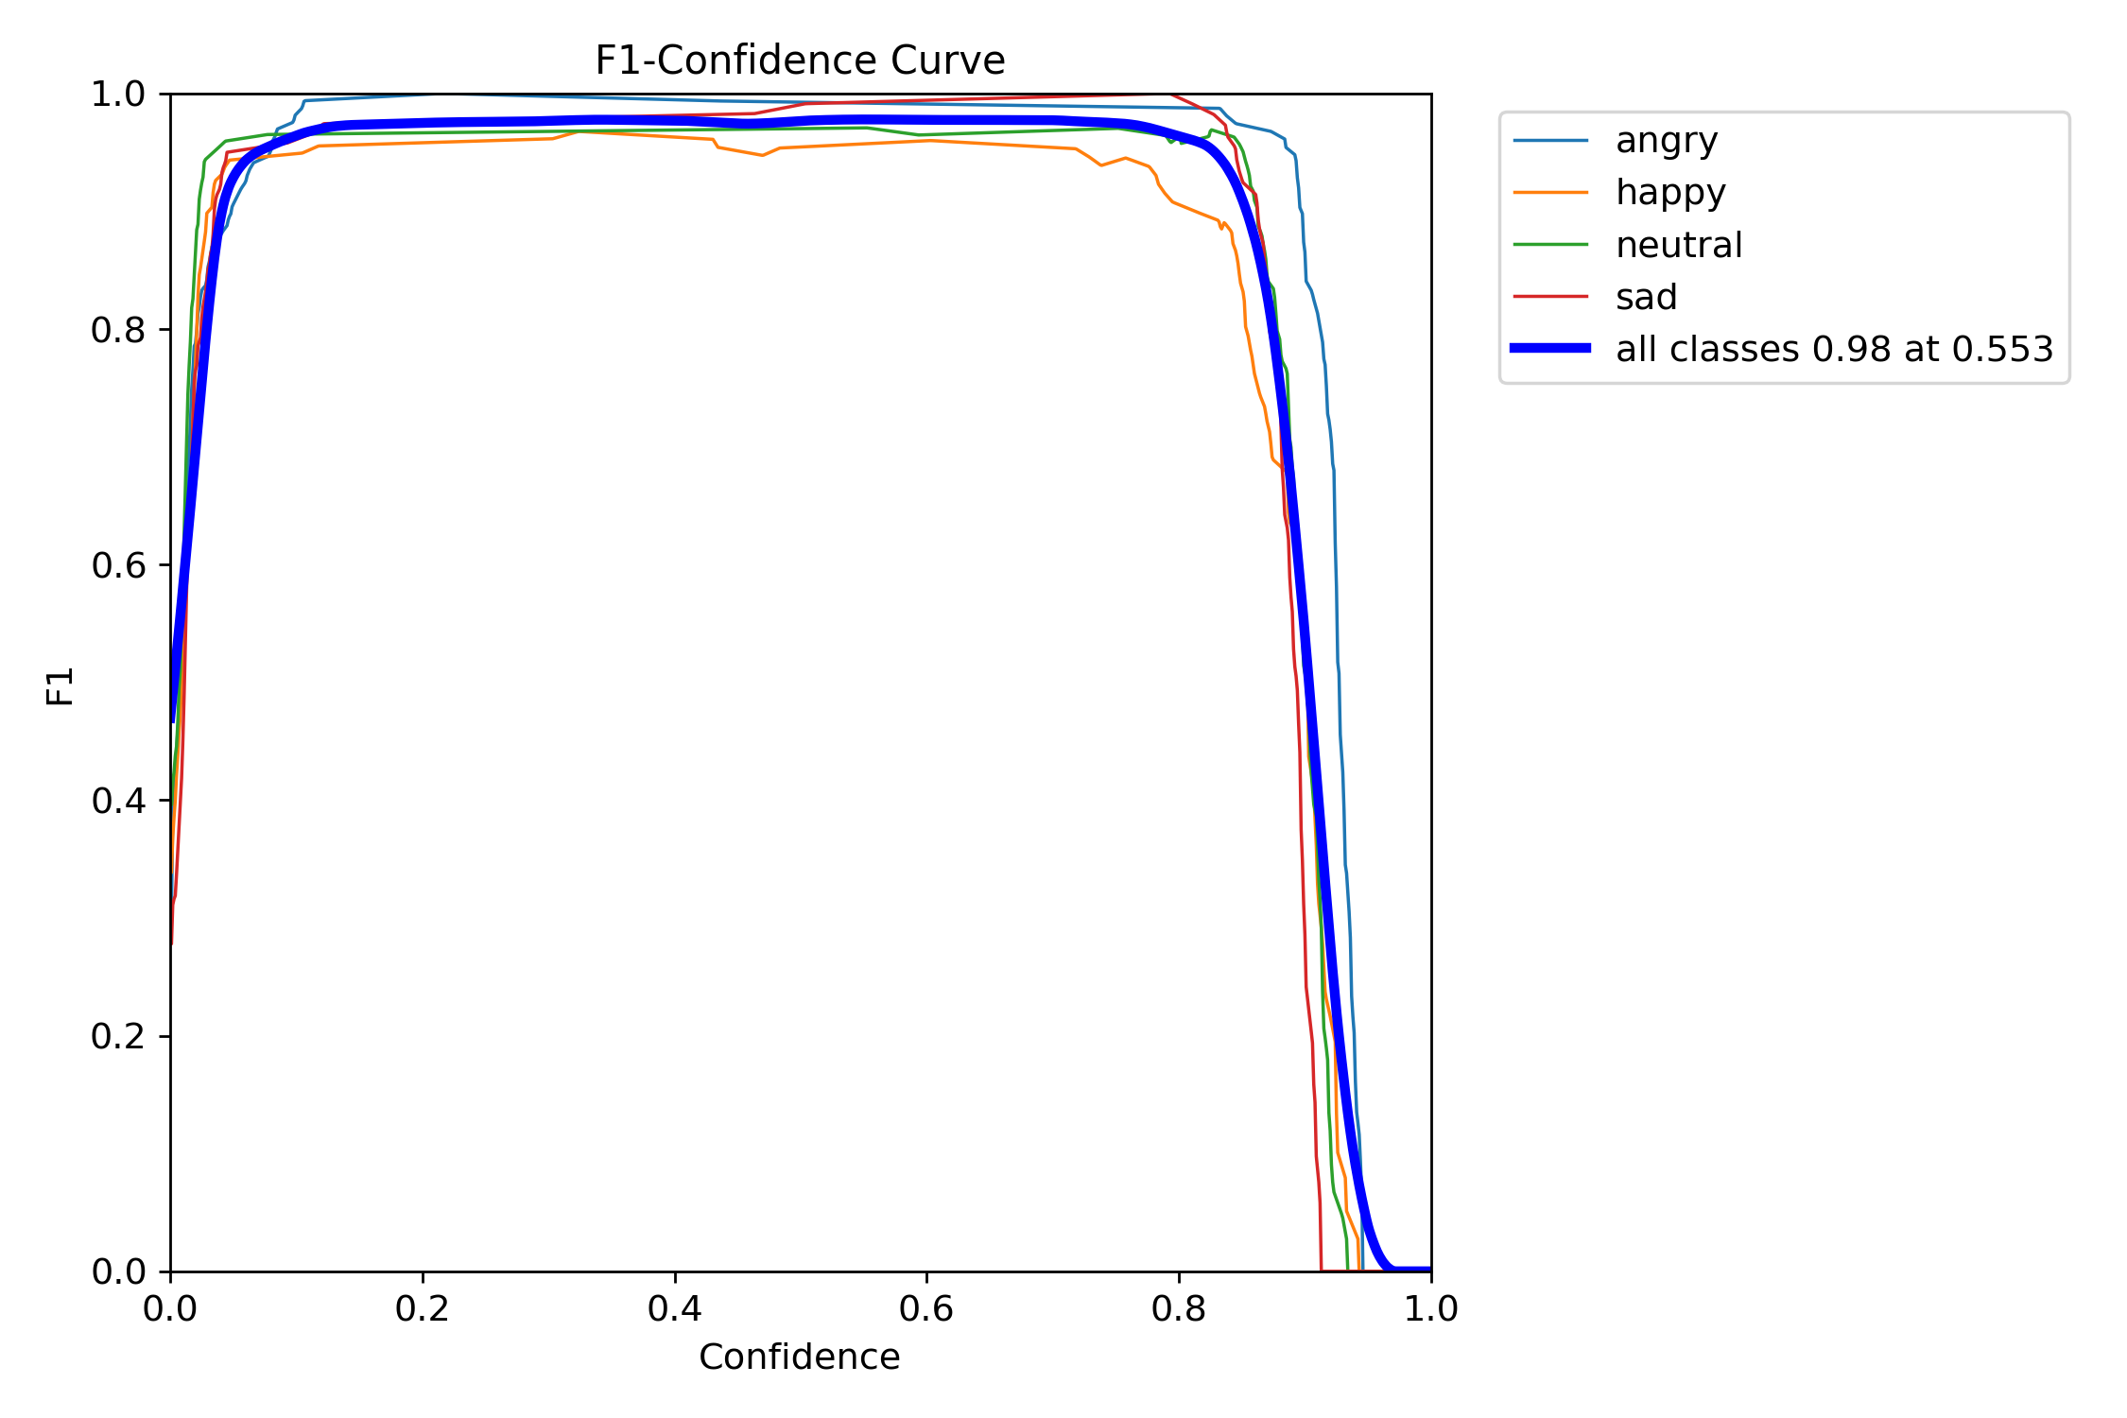
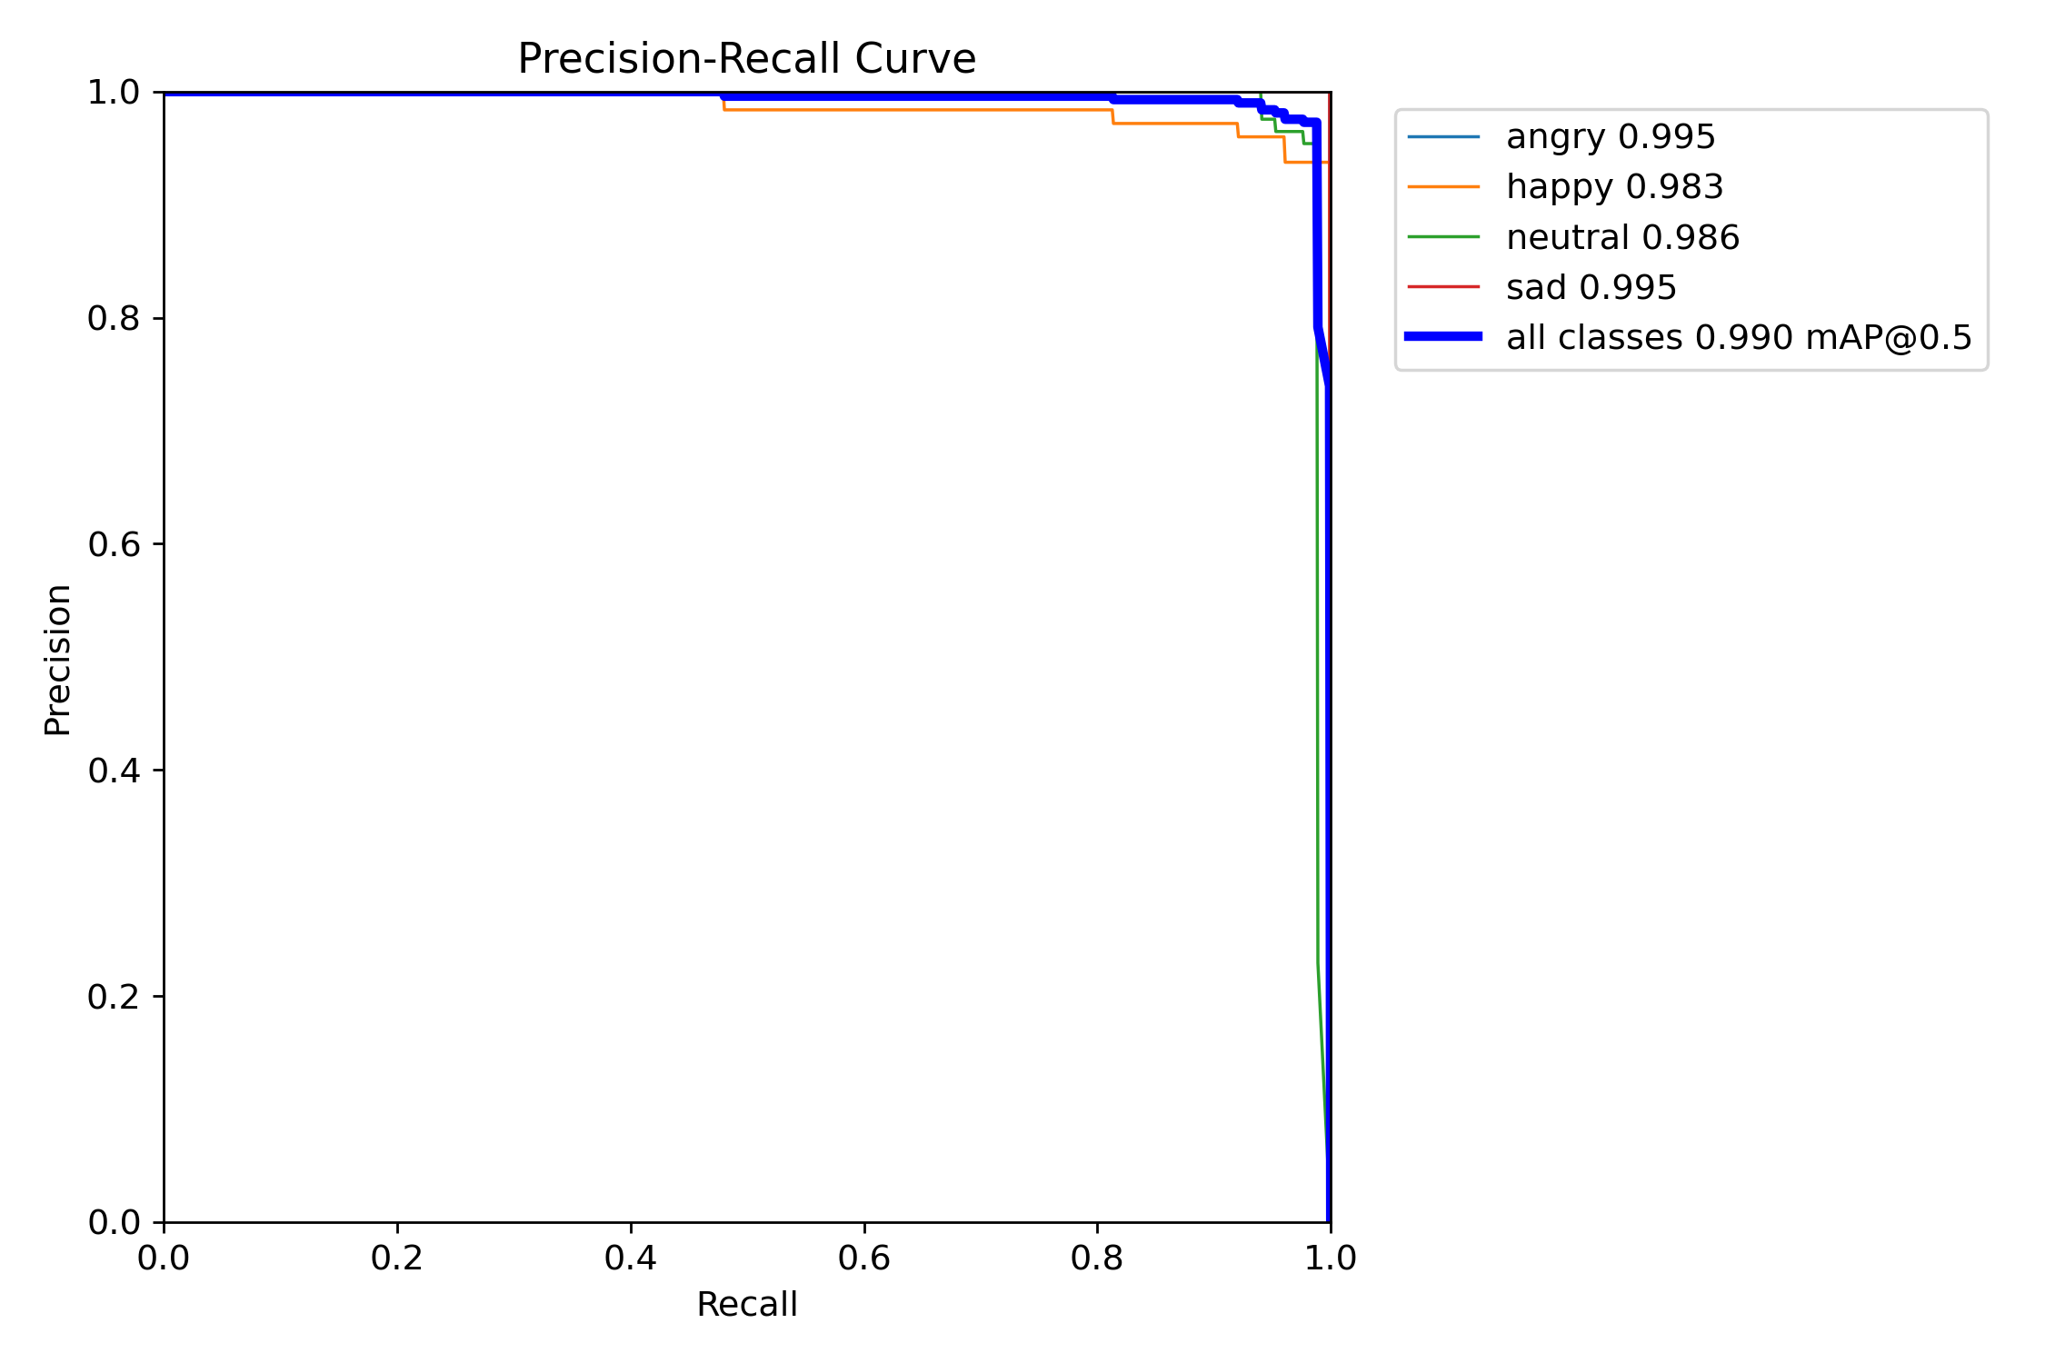
Training and Test Curves

Slide 11
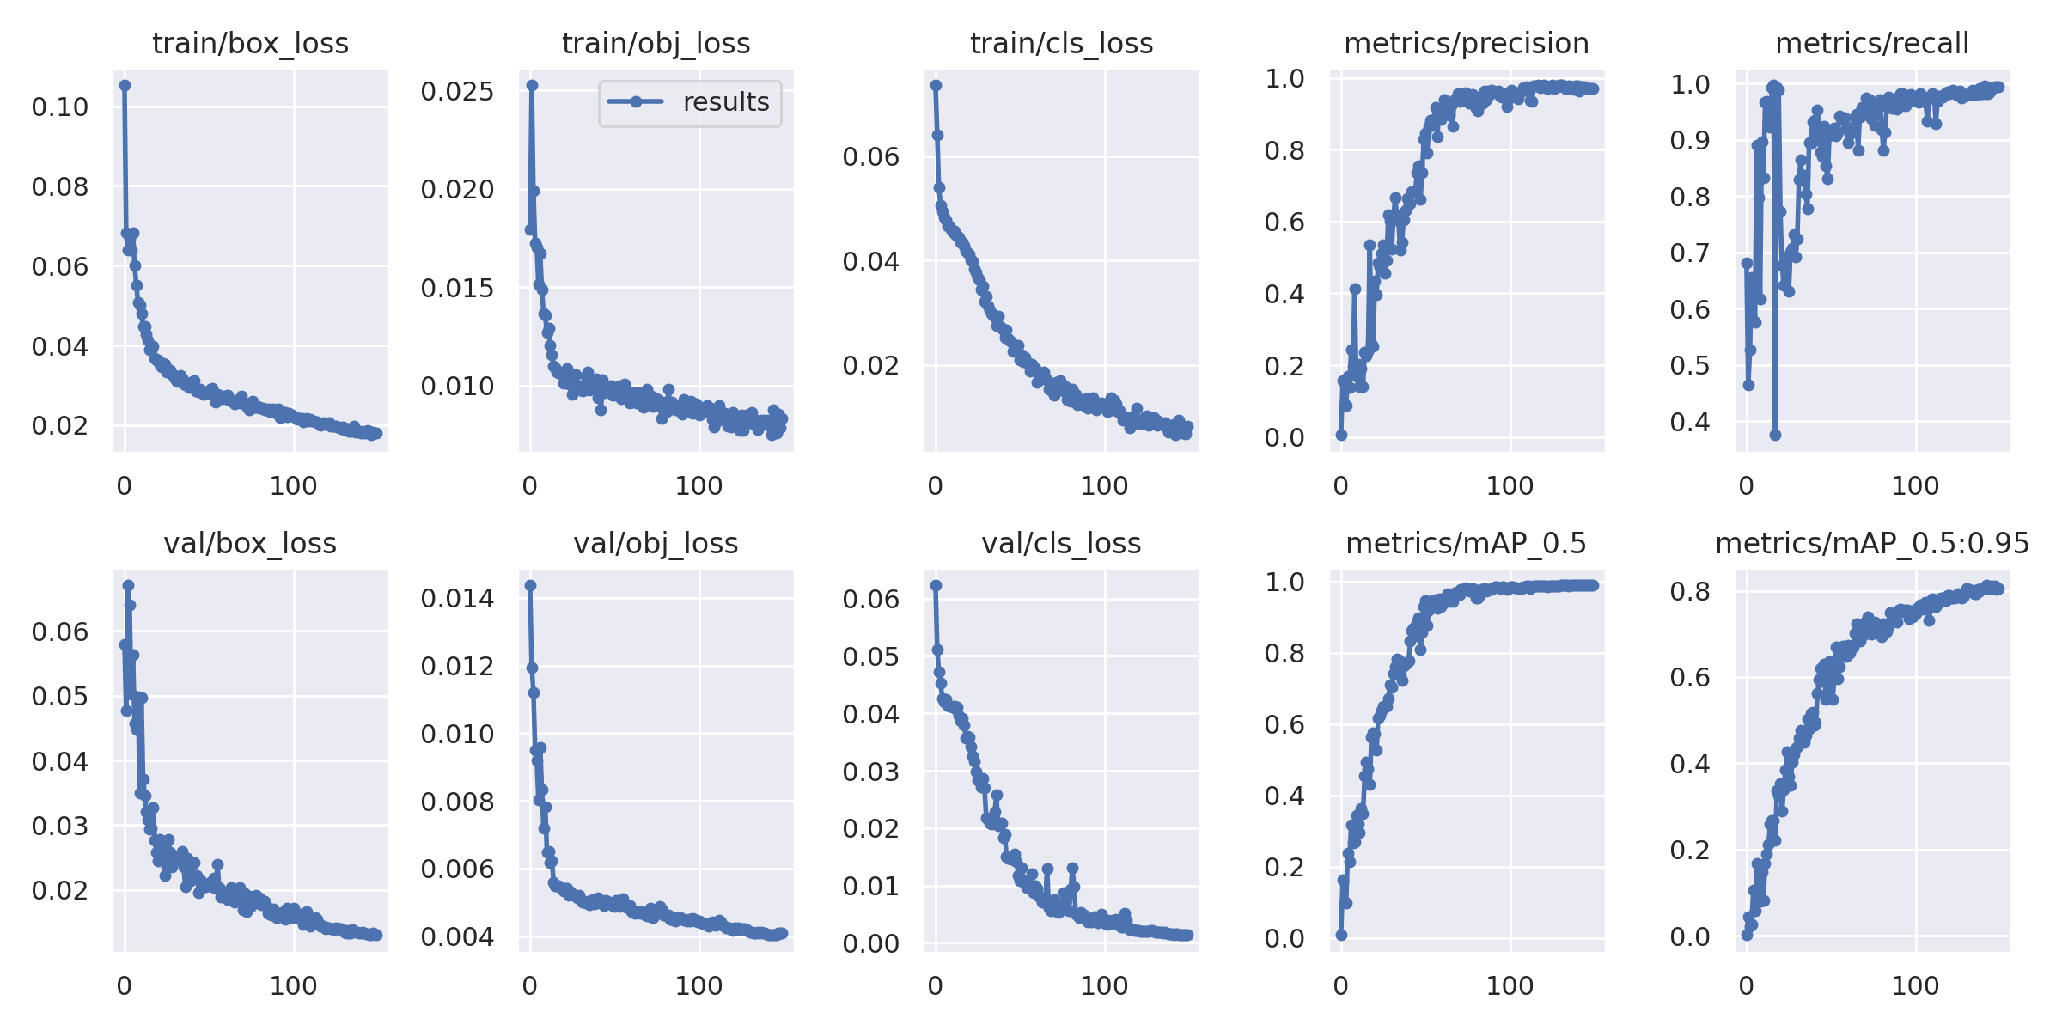
Model Evaluation

Slide 12
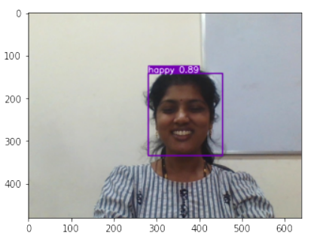
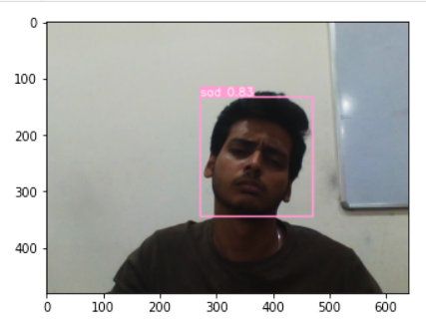
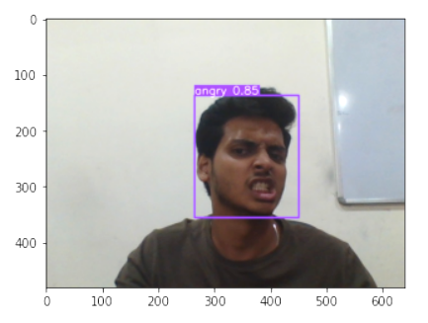
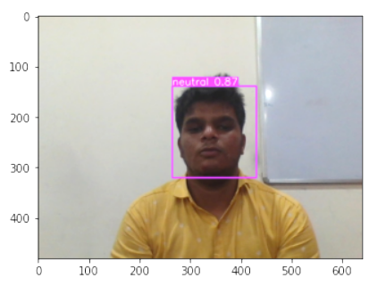
Final Results

Slide 13
Conclusion
The model has improved the average recognition rate for most categories of images. It can be seen that the model can effectively improve the detection performance. This provides some technical support to enhance the performance of the face emotion detection system.
Future Scope
Continuing to strengthen the detection of other categories of emotions is the focus of future work.
And the deployment of the project in a web application.

Slide 14
Challenges
We only captured 300 images for training due to which our accuracy was affected.
For achieving good accuracy we need more training data.
Training model on our dataset was taking too much time due to computational problem. So, we took the help of Google Colab (GPU) for training model.
Live prediction has been one of the most challenging thing in this project .
Scope for Improvement
Model has been trained only on captured images. In future, gathering more input images could improve the performance of the model. Both Grey scale and Color Images can be included

Slide 15
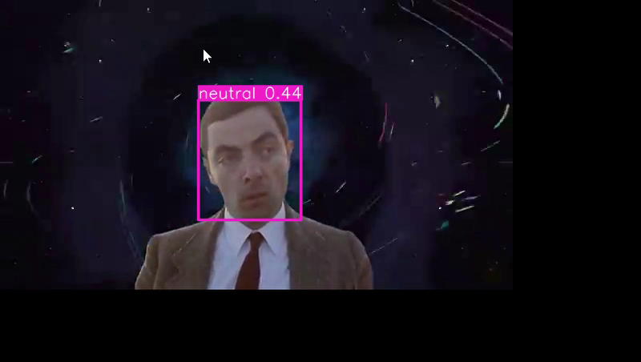
Final Demo

